Slide 1

Amp Up Your Presentations or How to Avoid PowerPoint Heck

Slide 2
Meeting Agenda
Soft Skills
Start Memory Game
Planning Skills
PowerPoint

Slide 3


Amp Up Your Soft Skills
Practice Speaking
Get Feedback

Slide 4
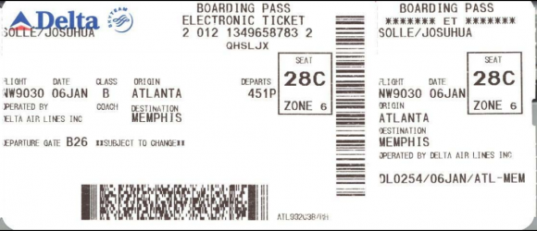
“Airport Game”

Slide 5
What’s your goal? Have a plan !

Slide 6
It’s a speech Don’t be boring.
Intro Grab their interest.
Don’t fumble the ball
Body Keep my attention
Conclusion End early. Please!!!

Slide 7
Questions?
When do you take questions?
Tone of meeting
1-way or interactive

Slide 8
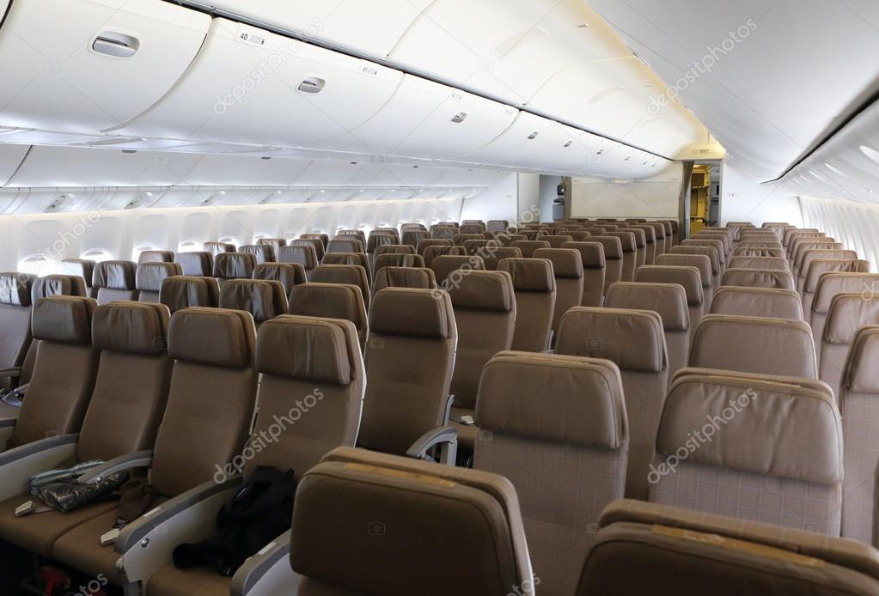
Game: Seat Number

Slide 9
Late arrivals

Slide 10
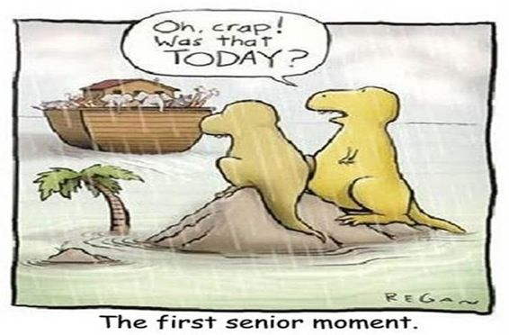
Expect Late arrivals

Slide 11

You can’t start the wedding without the couple.
No matter how mad you are,
No matter how late they are,

Slide 12
MITIGATE Late Arrival Distruptions
Decide who you will wait for.
Pre-confirm time / place
Start off-peak e.g. 10:05 AM

Slide 13
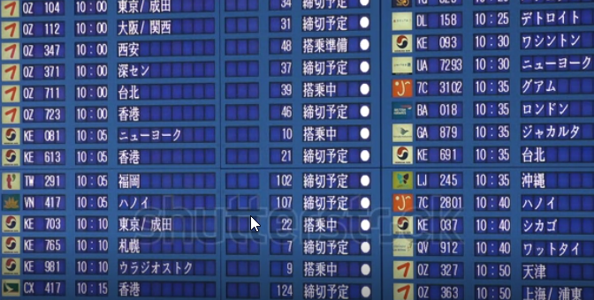
Game: Destination City

Slide 14

The time has arrived

Slide 15
Be prepared
Get there early
Bring your gear bag
Set up your laptop, log in
Set up the room
Greet folks when they arrive

Slide 16
HW Checklist
USB drive with presentation
Mouse & battery
Spare video cables
Power cord
Presentation clicker & laser

Slide 17
SW Checklist
Update & charge laptop
Reboot before the dry run
Get Internet password

Slide 18
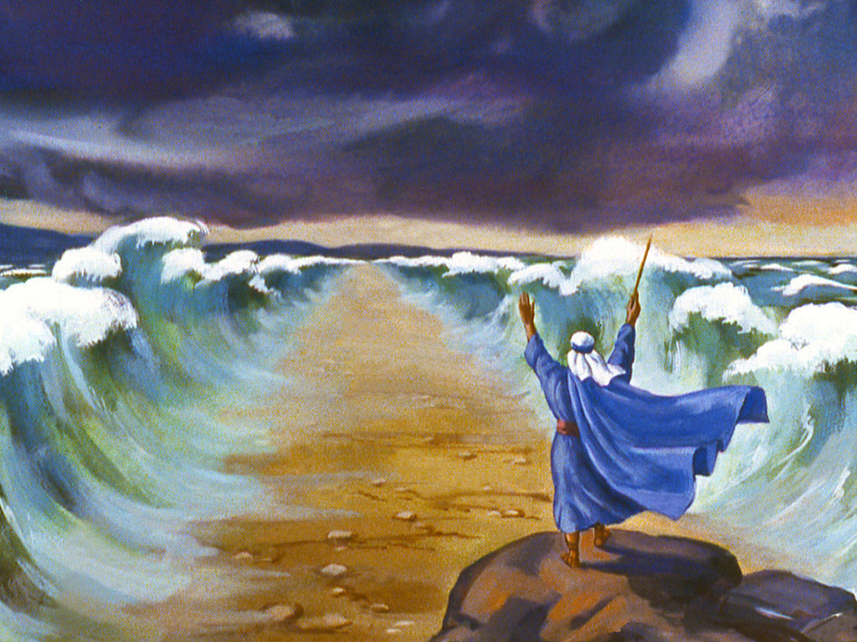
Begin PowerPointing

Slide 19
One Main Idea per slide

Slide 20
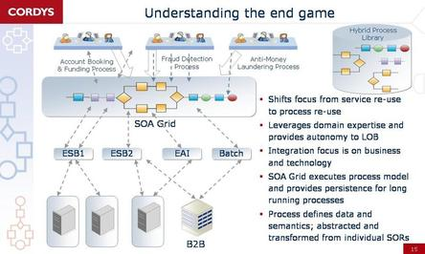
Not this

Slide 22
What was their “end game?”

Slide 23
Can you possibly remember ANY of that slide?

Slide 24
Your slide can be world famous bad, even make the front page of the New York Times!

Slide 25
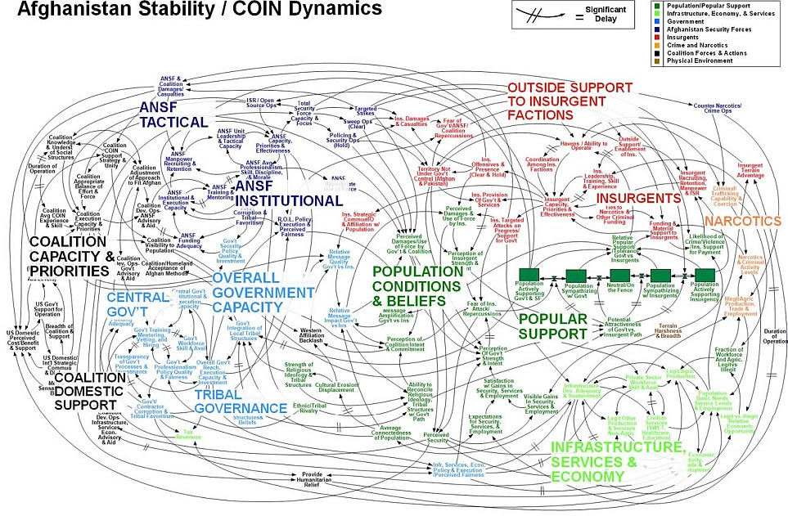

Slide 26
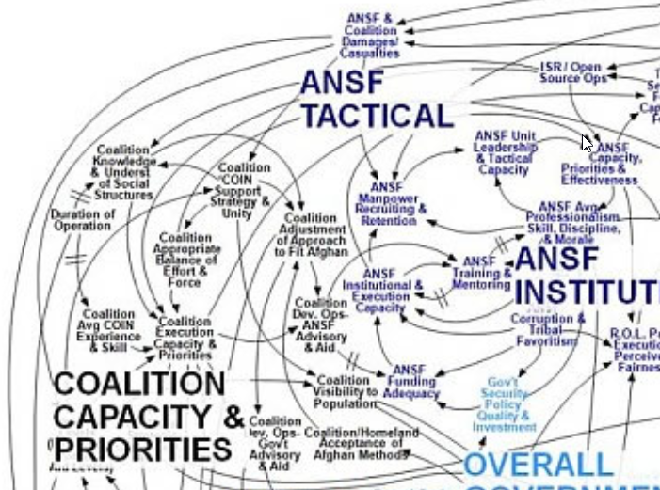

Slide 27
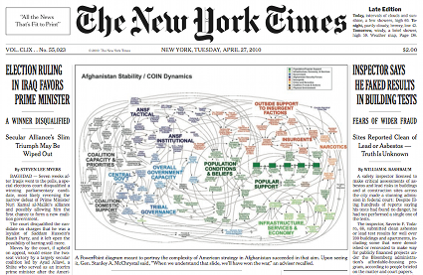

Slide 28
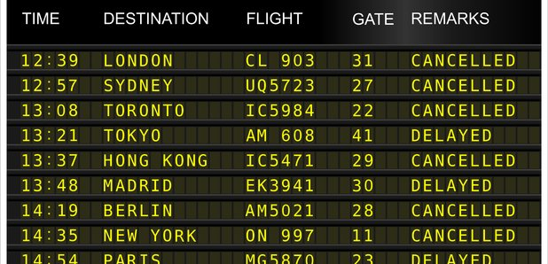
Game: Flight number

Slide 29
Fonts Size Matters:
60 font Calibri
44 font Calibri
40 font Calibri
32 font Calibri
24 font Calibri

Slide 30
Backgrounds:
Simple Dark backgrounds
Light / white letters

Slide 31
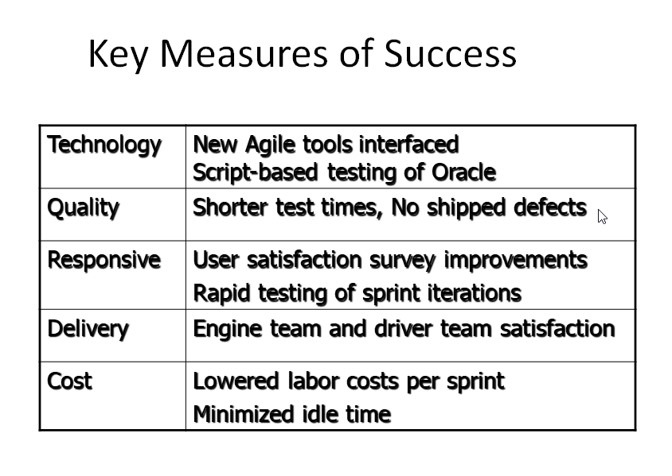

Slide 32
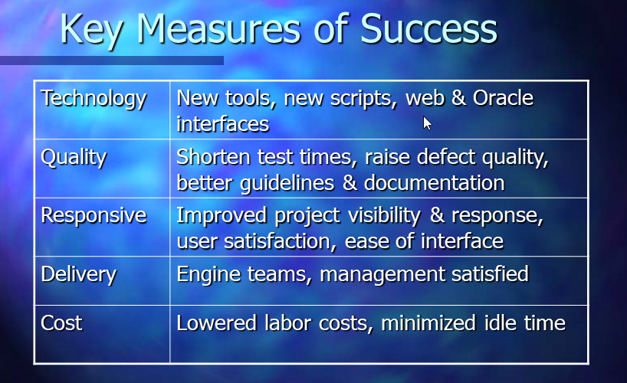
Not This

Slide 33
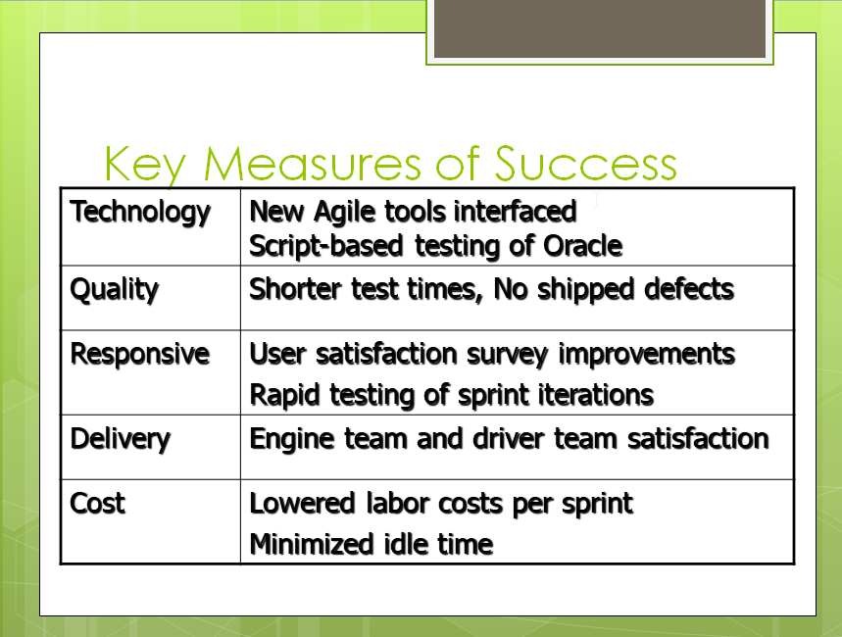
Not this

Slide 34
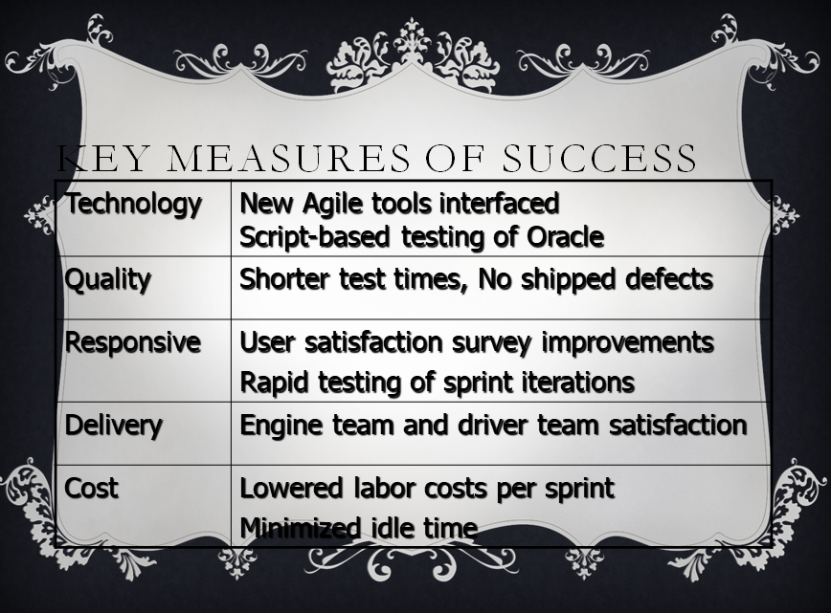
Not this either

Slide 35
Maybe this?
Technology | New Agile tools interfaced Script-based testing of Oracle
Quality | Shorter test times, No shipped defects
Responsive | User satisfaction survey improvements Rapid testing of sprint iterations
Delivery | Engine team and driver team satisfaction
Cost | Lowered labor costs per sprint Minimized idle time

Slide 36
Highlight rows
Technology | New Agile tools interfaced Script-based testing of Oracle
Quality | Shorter test times, No shipped defects
Response Time | User satisfaction survey improvements Rapid testing of sprint iterations
Delivery | Engine team and driver team satisfaction
Cost | Lowered labor costs per sprint Minimized idle time

Slide 37
Technology | New Agile tools interfaced Script-based testing of Oracle
Quality | Shorter test times, No shipped defects
Response time | User satisfaction survey improvements Rapid testing of sprint iterations
Delivery | Engine team and driver team satisfaction
Cost | Lowered labor costs per sprint Minimized idle time

Slide 38
Technology | New Agile tools interfaced Script-based testing of Oracle
Quality | Shorter test times, No shipped defects
Response Time | User satisfaction survey improvements Rapid testing of sprint iterations
Delivery | Engine team and driver team satisfaction
Cost | Lowered labor costs per sprint Minimized idle time

Slide 39
Fade rows
Technology | New Agile tools interfaced Script-based testing of Oracle
Quality | Shorter test times, No shipped defects
Response Time | User satisfaction survey improvements Rapid testing of sprint iterations
Delivery | Engine team and driver team satisfaction
Cost | Lowered labor costs per sprint Minimized idle time

Slide 40
Focus their Attention:
First here: Discuss this factoid
Then here: Move on to this one
Then here: Keep up with it
Finally here: Whew! I’m done

Slide 41
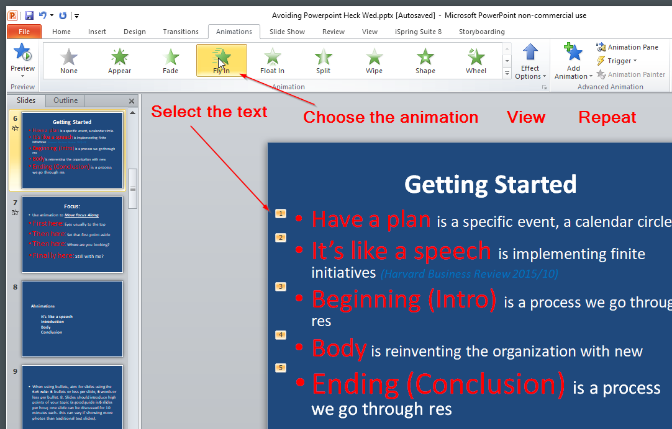

Slide 42
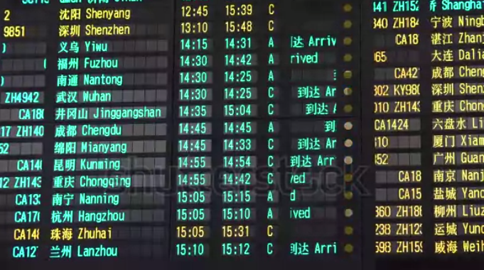
Game: Boarding Time

Slide 43

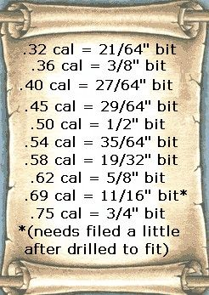
Bullet Rules Not these…

Slide 44
But these!
6 x 6 Rule
7 x 7 Rule
10/20/30 Rule

Slide 45
6 x 6 Rule for Bullets
6 bullets or less per slide.
6 words or less per bullet.
6 slides per hour, 10 minutes each slide
Can you imagine talking about this slide for 10 minutes? BORING!!!!

Slide 46
7 x 7 Rule
The 7x7 Rule states that a PowerPoint slide (or any other electronic slide) should have no more than seven lines of text and no more than seven words in each of those lines.
31 words in his slide sample sentence.

Slide 47
10 / 20 / 30 Rule
Guy Kawasaki said a PowerPoint presentation should have no more than Ten slides,
last no more than Twenty minutes,
and contain no font smaller than Thirty points.
Caveat: referring to venture capital presentations

Slide 48
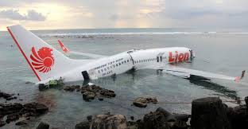
Game: Arrival Time

Slide 49
Printing Slides is a bad idea!
People look at the dead trees in their hand, not you.
Must distribute & clean up
Never enough, always left overs
Latecomers want one
Online people are left out

Slide 50
Change ➔Transformation
Change is a specific event, a calendar circle.
Change management is implementing finite initiatives (Harvard Business Review 2015/10)
Transition is a process we go through responding to a change… a constellation of thought, feeling and actions. Lee Chaix McDonough
Transformation is reinventing the organization with new or revised business models based on a vision of the future. (HBR 2015/10)

Slide 51
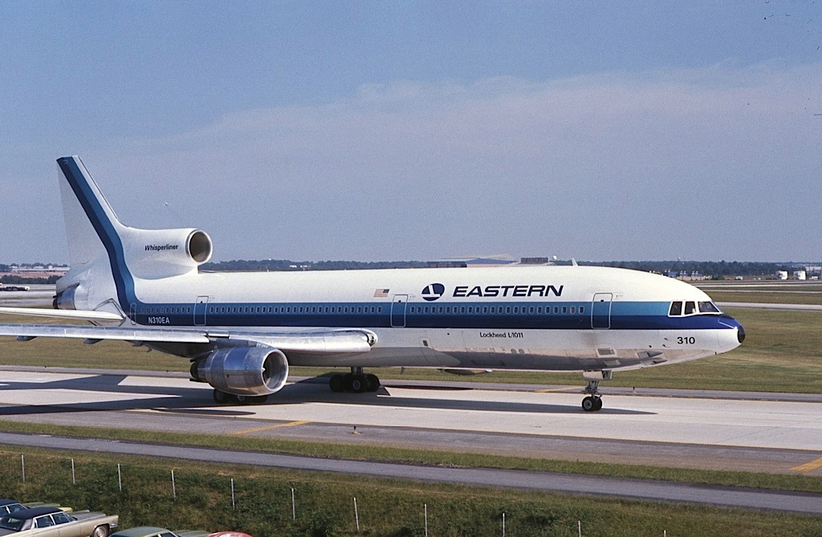
Game: Airline Name

Slide 52
Show me a Video
Offline Video:
Create the content, mind the size!
Online Video:
Need Internet + Bandwidth

Slide 53
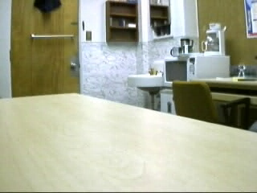

Insert a Video

Slide 54
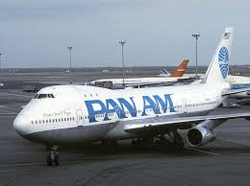
Game: Boarding Group Number

Slide 55
How much can humans see? Count the balls as quickly as you can and shout out the number.

Slide 56


Slide 57


Slide 58
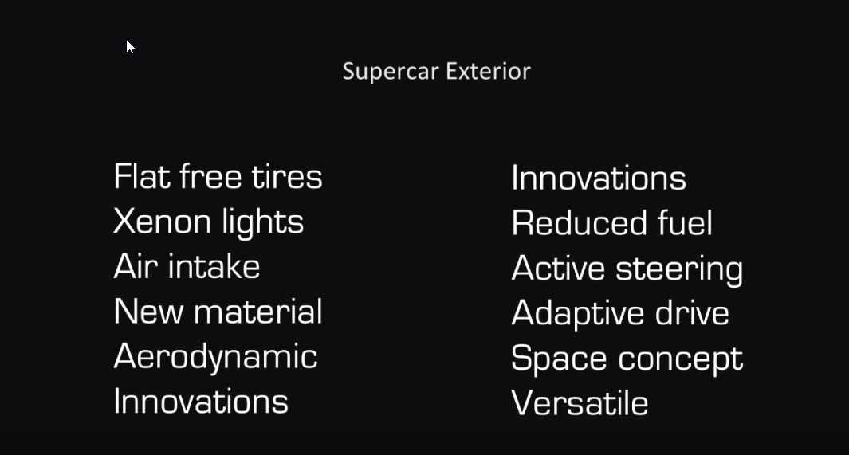

Slide 59
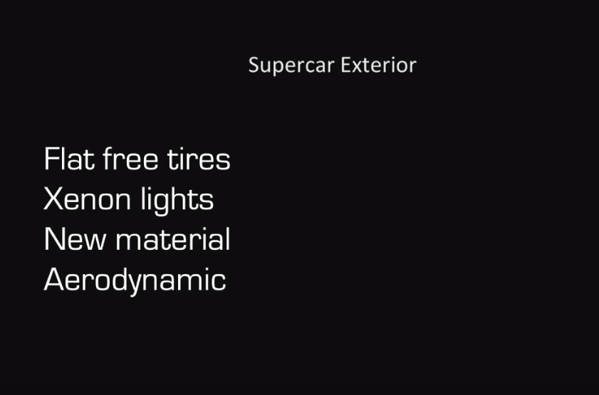

Slide 60
It’s not the number of slides that is important,
It’s the number of objects in your slides

Slide 61
Game: Seat Number

Slide 62
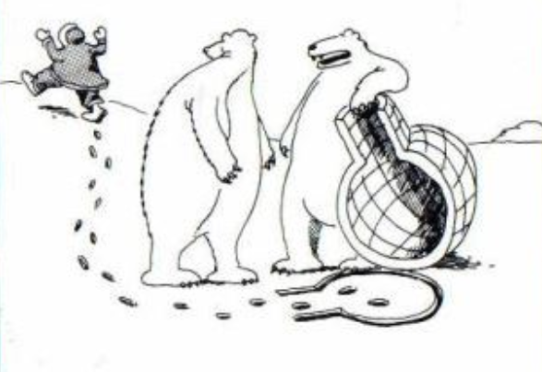
I lift, you grab. Was that concept just a little too complex, Carl?

Slide 63

Let’s meet for coffee or lunch.
Joel Robinson
JoelHRobinson @ Gmail.com
208-602 8478

